Slide 1

Early Attrition Alerts Business Services Batch Model
Autumn Li
1/12/2021

Slide 2


Why Early Attrition Alerts?
Attrited accounts share similar characteristics
Statistics empowers us to predict which accounts are more likely to attrite
The sales team could reach out to accounts that receive attrition alerts and do their best to prevent them from attrition.

Slide 3
What does the attrition model tell us about our customers?
Customers with declining trends on transaction usage or the number of active users are highly likely to attrite.
Customers with missing transaction months in past 3 months are more likely to attrite.
Customers with account issues are more likely to attrite.
Customers who have been on the books for a long time are less likely to attrite.
Customer who didn’t meet the minimum usage commitment are more likely to attrite
* Above customer behaviors are based on the attribute characteristics from the statistical model

Slide 4
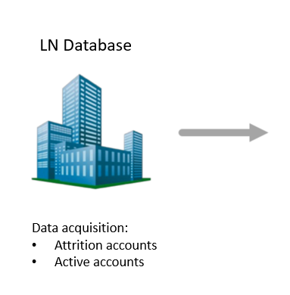
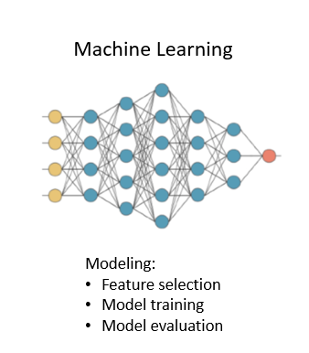
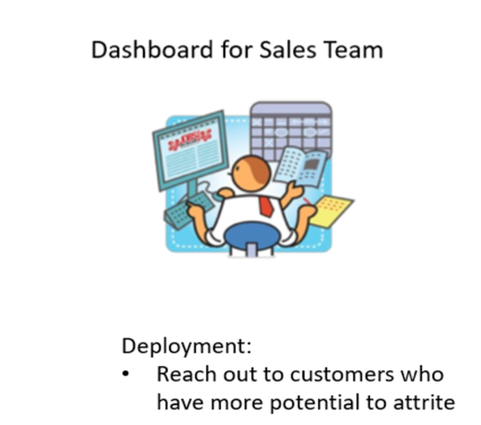

Modeling Process

Slide 5
Model Population Waterfall: Active Accounts
Whole population
All Active batch accounts created before Sept, 2020 * | 1,384 accounts
Criteria 1 - Excluded platform in 'BRG', 'WCI', 'WCO' | 1,384 accounts
Criteria 2 - At least 12 months on books | 1,356 accounts
Criteria 3 - Activity year_month is between (201809, 202009) | 1,284 accounts
Criteria 4 - Have 12 months total revenue > $500 | 1,141 accounts
Criteria 5 - Have 12 months total usage > 0 | 1,078 accounts
Population criteria
Target
Final valid population accounts | 1,078 accounts
*There are 1446 accounts have no attrition date, which means these accounts might be active
* There are 1,384 accounts have no attrition date and “active” account status, which means these accounts are true active accounts

Slide 6
Model Population Waterfall: Attrited Accounts
Whole population
All Attrited batch accounts created before Sept, 2020 * | 339 accounts
Criteria 1 - Excluded platform in 'BRG', 'WCI', 'WCO' | 339 accounts
Criteria 2 - At least 12 months on books | 320 accounts
Criteria 3 - Attrition year_month is between (201809, 202009) | 288 accounts
Criteria 4 - Have 12 months total revenue > $500 | 245 accounts
Criteria 5 - Have 12 months total usage > 0 | 220 accounts
Population criteria
Target
Final valid population accounts | 220 accounts
*There are 511 accounts have attrition date, which is the weak evidence for attrition
* There are 339 accounts have both attrition date and inactive account status, which is the stronger evidence of attrition

Slide 7
Training &Testing Population
1,078 Active Accounts
220 Attrited Accounts
1,298 Total Accounts
75% Training Dataset
( 973 Accounts)
25% Testing Dataset
(325 Accounts)

Slide 8


Population Characteristics
Average usage
Average active user
Average customer age
31,255 searches
5 active users
3,779
Days
(9 Years and 3 Months)
Active accounts
9,084 searches
2 active users
2,507
days
(6 Years and 10 Months)
Attrited accounts

Slide 9

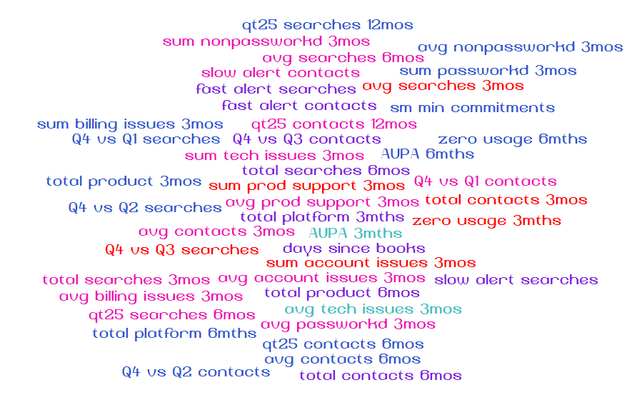
Variable creation and selection
With 51 behavior features, how to find the important ones?

Slide 10
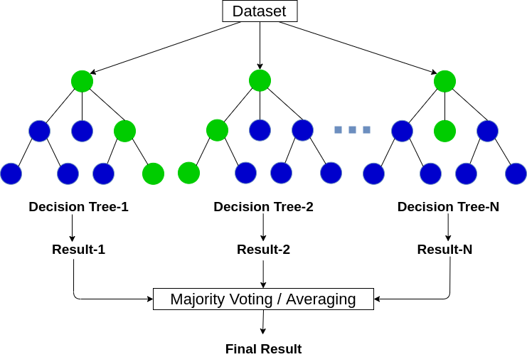
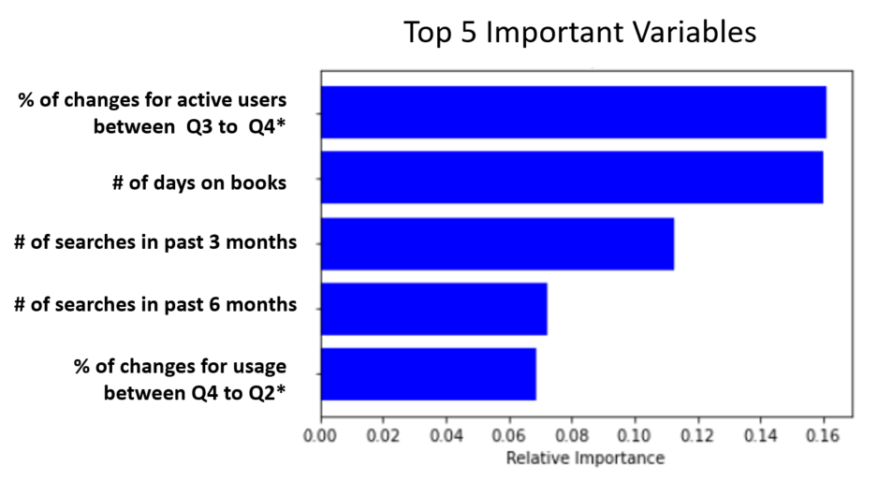
Variable selection
Random Forest Varable importance ranking
How it works?
Random forests (RF) construct many individual decision trees at training.
Feature importance is calculated as node probability
The node probability can be calculated by the number of samples that reach the node, divided by the total number of samples. The higher the value the more important the variable.
*Q3 stands for the 3rd quarter, Q4 stands for the 4th quarter, Q2 stands for the 2nd quarter

Slide 11
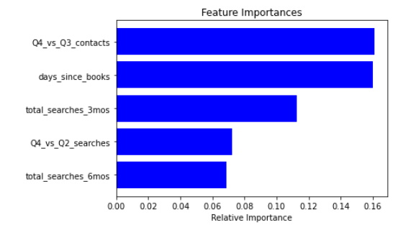
Feature selection
Random Forest Feature importance ranking
How it works?
Random forests (RF) construct many individual decision trees at training.
Feature importance is calculated as node probability
The node probability can be calculated by the number of samples that reach the node, divided by the total number of samples. The higher the value the more important the feature.
Top 5 Important Variables
% of changes for active users between Q3 to Q4*
# of days on books
# of searches in past 3 months
# of searches in past 6 months
% of changes for usage between Q4 to Q2*
*Q3 stands for the 3rd quarter, Q4 stands for the 4th quarter, Q2 stands for the 2nd quarter

Slide 12
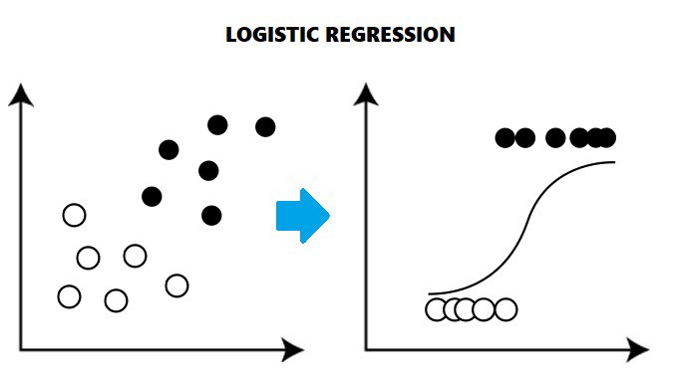
Modelling
Traditional logistic regression
A basic statistical model to predict binary dependent variables, such as active accounts and attrited accounts
Machine learning –Xgboost
XGBoost is well known to provide better solutions than other machine learning algorithms
A highly flexible machine learning algorism that can work through most regression and classification
XGBoost
Extreme Gradient Boosting
Custom tree building algorithm
Interfaces for Python and R
Classification
Regression
ranking

Slide 13
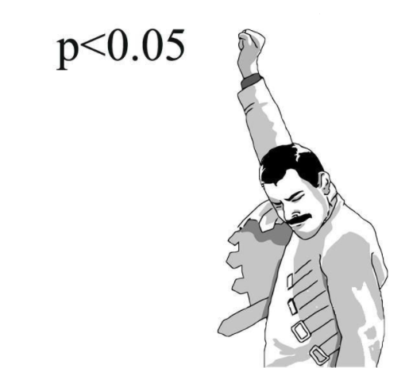
Modelling-Logistic Regression Results
Variable | Z-value | P>|z|
% of changes for number of active users bwteen 3rd quarter to 4th quarter | 7.418 | 0
Number of months without any usage in past 3 months | 4.004 | 0
Number of days since the account has been created | -3.995 | 0
Total number of products in the past 3 months | -3.073 | 0.002
Number of customer service relates to account issues | 2.777 | 0.005
Number of customer service relates to billing issues | -2.214 | 0.027
If monthly average usage < min commitments (100), alert = 1 | 2.06 | 0.039
The decline of transaction usage* | 2.041 | 0.041
Total usage in the past 3 months | -1.38 | 0.165
* % difference between average Transaction Usage in 3 months leading up to attrition date and bottom 25th percentile of Transaction Usage over time

Slide 14
Logistic Regression Results Interpretation
Behaviors | Variable | Less likely / More likely to attrite
Active users changes | % of changes for active users from 3rd quarter to 4th quarter | More changes, more likely to attrite
Abnormal small usage | Number of months without any usage in past 3 months | More months without any usage, more likely to attrite
Customer age | Number of days since account creation date | More number of days on books, less likely to attrite
Product diversity | Total number of products in the past 3 months | More number of products, less likely to attrite
Customer service | Number of customer service relates to account issues | More number of account issues, more likely to attrite
Customer service | Number of customer service relates to billing issues | More number of billing issues, less likely to attrite
Abnormal small usage | If monthly average usage < min commitments (100), alert = 1 | More abnormal small usage, more likely to attrite
Declining negative customers | The decline of transaction usage* | More decline of usage, more likely to attrite
Customer usage | Total usage in the past 3 months | More searches, less likely to attrite
* % difference between average Transaction Usage in 3 months leading up to attrition date and bottom 25th percentile of Transaction Usage over time

Slide 15
Logistic Regression Results Interpretation
ORIGINAL
Behaviors | Variable Definition | Less likely / More likely to attrite
Customer usage | Total usage in the past 3 months | More searches, less likely to attrite
Product diversity | Total number of products in the past 3 months | More # of products, less likely to attrite
# of Active users | % of changes for active users from 3rd quarter to 4th quarter | More changes in active users, more likely to attrite
Customer age | Number of days since account creation date | More days on books, less likely to attrite
Declining negative customers | The decline of transaction usage * | More decline of the usages, more likely to attrite
Abnormal small usage | If monthly average usage < min commitments (100), alert = 1 | More abnormal small usage, more likely to attrite
Abnormal small usage | Number of months without any usage in past 3 months | More zero usage, more likely to attrite
Customer service | Number of customer service relates to account issues | More account issues, more likely to attrite
Customer Service | Number of customer service relates to billing issues | More billing issues, less likely to attrite
* % difference between average Transaction Usage in 3 months leading up to attrition date and bottom 25th percentile of Transaction Usage over time

Slide 16


Logistic Regression Model Evaluation
Decile | # Attritors | # Non Attritors | Total # Testing Customer | Attrition Rate
1 | 15 | 18 | 33 | 23.44%
2 | 13 | 19 | 32 | 20.31%
3 | 10 | 23 | 33 | 15.63%
4 | 7 | 25 | 32 | 10.94%
5 | 5 | 27 | 32 | 7.81%
6 | 3 | 30 | 33 | 4.69%
7 | 4 | 28 | 32 | 6.25%
8 | 3 | 30 | 33 | 4.69%
9 | 3 | 29 | 32 | 4.69%
10 | 1 | 32 | 33 | 1.56%
Total | 64 | 261 | 325 | 100%
More likely to leave
How To Read this Chart:
Attrition model scores every customer based on likelihood of leaving
Customers are rank ordered based on scores and placed into deciles (Decile 1 = most likely to leave LN)
Actual counts of Attritors and Non-Attritors are used to gauge the performance of the model

Slide 17
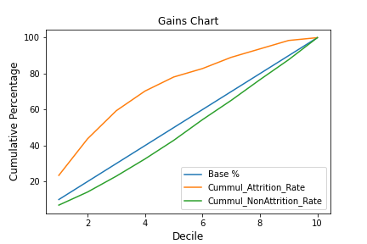
Logistic Regression Model Evaluation
70.31%
KS = 37.74
32.57%

Slide 18
Modelling-XGBoost
XGBoost
XGBoost implements the algorithm for decision tree boosting with an additional custom regularization term in the objective function
Boosting is a sequential technique which works on the principle of an ensemble. It combines a set of weak learners and delivers improved prediction accuracy
Decile | # Attritors | # Non Attritors | Total # Customer | Attrition Rate
1 | 19 | 14 | 33 | 29.69%
2 | 11 | 21 | 32 | 17.19%
3 | 8 | 25 | 33 | 12.50%
4 | 5 | 22 | 27 | 7.81%
5 | 7 | 30 | 37 | 10.94%
6 | 6 | 23 | 29 | 9.38%
7 | 2 | 33 | 35 | 3.13%
8 | 1 | 32 | 33 | 1.56%
9 | 4 | 29 | 33 | 6.25%
10 | 1 | 32 | 33 | 1.56%
Total | 64 | 261 | 325 | 100%
More likely to leave

Slide 19

Modelling-XGBoost
59.36%
KS = 36.37
22.99%

